Slide 1


Skip Counting
Lesson Plan:
Adaptable (great for ages 5-9)

Slide 2
Learning Objectives
Students will
Recognize and extend skip-counting patterns
Students will
Understand skip counting as repeated addition
Students will
Build fluency through movement, music, and hands-on activities
Students will
Demonstrate understanding verbally, physically, or in written form

Slide 3
Standards Alignment General
1 | Number Sense and operations
2 | Recognizing patterns in numbers
3 | Foundations for multiplication

Slide 4
Key Concept
🧠 Skip counting is repeated addition (ex: counting by 2 = adding 2 each time.)

Slide 5

Warm-Up: Skip Counting Songs
👉 Use skip counting songs from Homeschool Helper (Link to YouTube Channel)
How to use:
Play the song for the chosen number (ex: counting by 2s)
Encourage movement (clapping, bouncing, marching)
Repeat daily for consistency
👉 This builds rhythm + memory (especially helpful for auditory learners)

Slide 6


Hands-On Activity: Build & Count
Materials:
  Blocks or manipulatives
  Steps:
  Have your child build stacks
    Counting by 2 → stacks of 2
    Counting by 3 → stacks of 3
    Line the stacks up
    Count each stack together
    Connect the Learning:
    Each time we add another stack, we are adding 2 more.
    Reinforce: Skip counting = adding the same number over and over again.

Slide 7

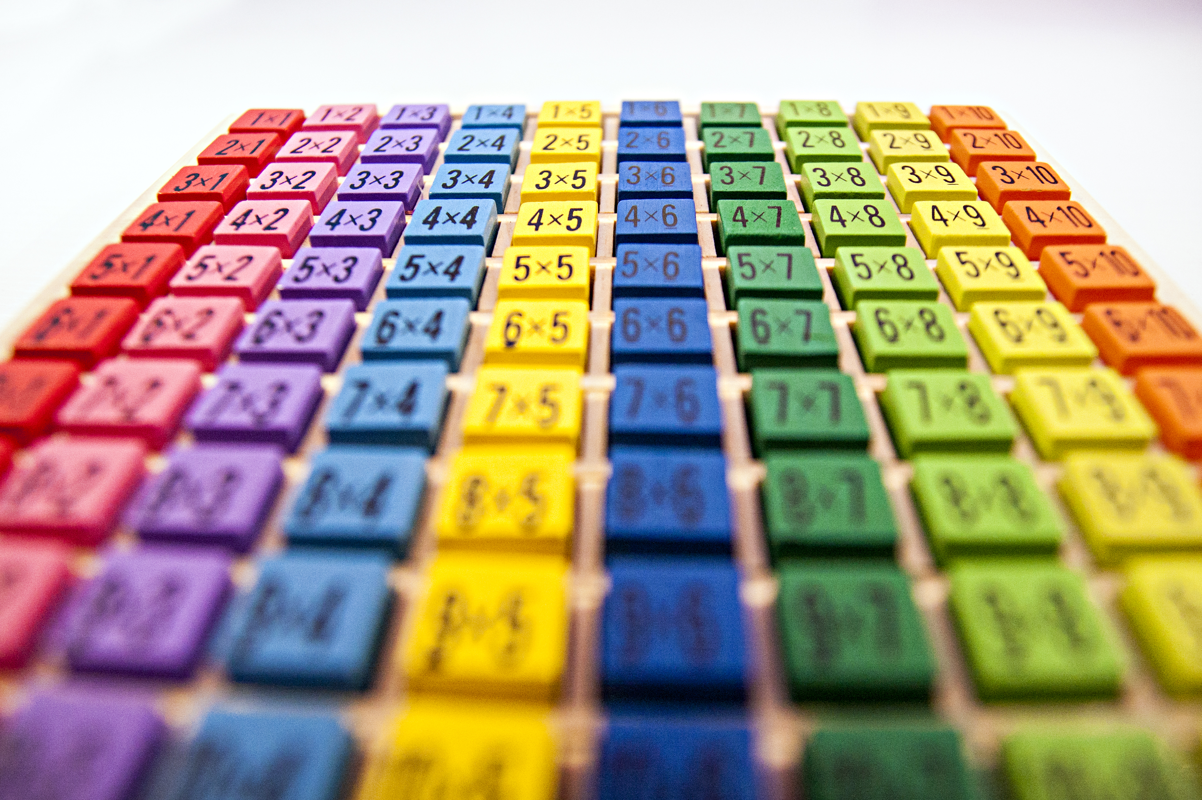

Number Card Sequencing
Materials:
  Number cards (from starting number to x15 sequence)
    Example (by 2s): 2-30 (start with only 1-2 numbers a day, based on your child’s level)
  Steps:
  Place cards in order together
  Read the sequence aloud
  Mix them up and reorder
  👉 This supports visual pattern recognition
Notes:
I attached sample number cards - but you could also build your own bigger cards by folding and cutting a piece of paper into 16 equal squares. (This would also help to color code them if that is helpful)

Slide 8

Movement Game: Toss & Count
How to Play:
  Toss a ball back and forth (we use a kickball
  Say the next number in the sequence with each toss
    Alternative:
    Jump on a trampoline while counting aloud
    👉 Great for regulation + memory (especially for sensory seekers)

Slide 9

Game: What Comes Next?
Setup:
  Scatter number cards randomly on the table or the floor
  How to play:
  You count aloud through the sequence
  Pause at a random number
  Student finds the next number
  *Note for parents: This can become a semi-independent activity – you could be cleaning, prepping food, or getting ready for the day, and they can find the card and bring it to you. This can also be done while driving (give them the cards, and they can find the next one and tell you what it is (or with no cards, they can just tell you what is next)
  👉 Builds prediction + pattern fluency

Slide 10
Independent Practice/Output
Worksheet:
Options for completion:
Title: “Count by ____”
15 blank lines
Write numbers independently
Dictate while you write
Count aloud only
Use AAC device to select numbers if this is the primary form of communication
👉 Keeps it accessible while still showing understanding

Slide 11
🧩Differentiation (Already Built Into Your Routine 🙌)
Fine motor challenges: Dictate or use cards instead of writing
Communication differences: AAC or verbal counting
Attention needs: movement-based counting (ball, trampoline)
Processing support: repeated songs daily for predictability

Slide 12
Additional Low-Prep Learning Tools (Optional Add-Ons)
The Following slides are simple upgrades – not more work, just more reinforcement

Slide 13

🎨 1. Color-Coded Sequences
Assign each skip count a color:
2s = Blue
3s = green
Write or highlight numbers in that color
👉 Helps visual memory + reduces confusion between patterns

Slide 14
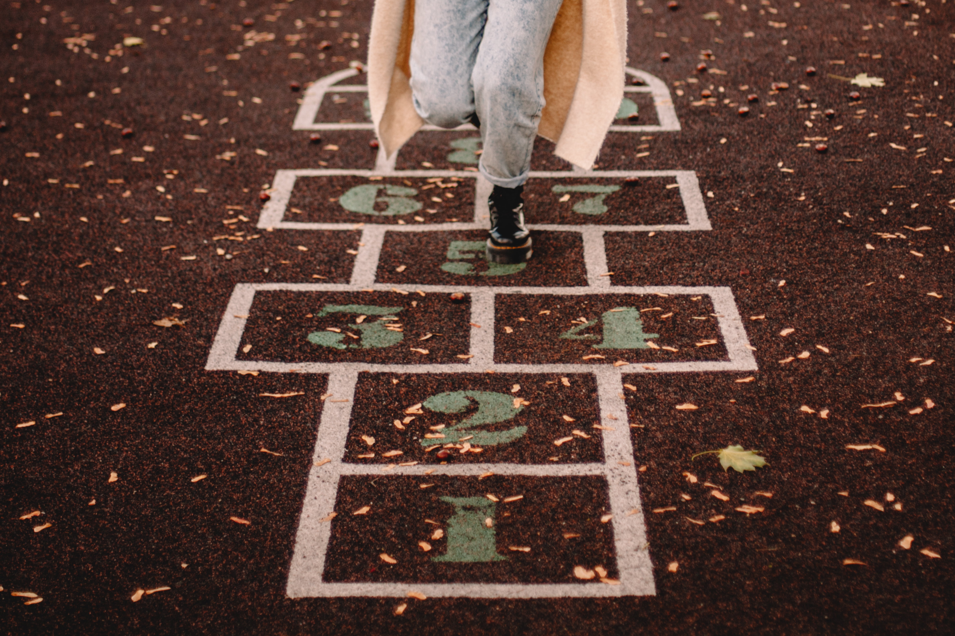
🧠 2. Pattern Noticing Questions
Casually ask:
What do you notice about these numbers?
Do they all end the same? (great for 2’s, 5’s, 10’s)
👉 Builds deeper number sense

Slide 15

🧍‍♀️ 3. Body Skip Counting
Turn their knees, shoulders, and /or head while counting
Step forward each number
👉 Engages kinesthetic learners

Slide 16

🧩 4. Skip Counting Hop Path
Make
Make a simple path:
Write
Write numbers on paper
Lay
Lay them on the floor
Jump
Jump from number to number
👉 Think: life-size number line

Slide 17

🔁 5. Daily Spiral Practice (2 minutes)
Quick Review:
Day 1: Count by 2s
Day 2: Count by 3s
Day 3: Mix them
👉 Keeps it fresh without reteaching

Slide 18

🎯 6. Real-Life Connection
Casually bring it into life:
We have 2 cookies each – let’s count by 2s
3 LEGO bricks each – count by 3s
👉 Makes math meaningful

Slide 19
Closing Reflection
Ask:
What pattern did you learn today?
What helped you remember the numbers?
Notes:
* If your child doesn’t have the language for this (one of mine doesn’t), no worries – you can always ask which activities were their favorite and why.

Slide 20
💡 Summary
This lesson blends:
Music 🎵
Movement 🏃‍♀️
Hands-on building 🧱
Visual patterns 🔢
…which is exactly what helps skip counting stick, especially for kids who need multi-sensory learning.

